Slide 1
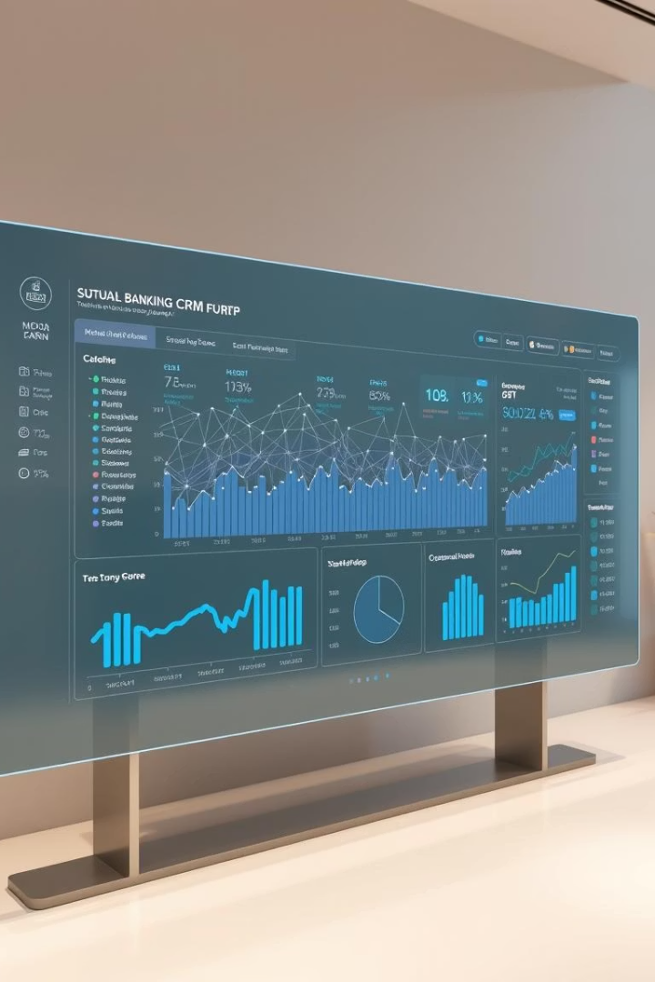
Analytical CRM Development for Banking Sector
Submitted by: Saubhagya Monal

Slide 2

Agenda
Problem Statement
Data Description
Objective Key Metrics and Visualizations
Subjective Question for Insights

Slide 3
Problem Statement
Customer churn, or the rate at which customers discontinue using our bank's services, significantly impacts our revenue and profitability.In this presentation, we will examine our bank's customer churn rates, focusing on factors such as gender, recent trends, credit card ownership, the number of products used, credit scores, and the regions from which customers are departing.The main objective is to identify the reasons behind customer attrition and propose strategies to enhance customer satisfaction and retention.

Slide 4
Methodology
Problem Understanding & Data Analysis: Initial analysis focused on the problem statement, followed by data exploration to identify key patterns and inconsistencies.
SQL Implementation: Utilized SQL commands such as SELECT, GROUP BY, ORDER BY, JOINs, window functions,RIGHT(), UPDATE, and ALTER to extract and manipulate data.
Power BI Dashboard Development: Created calculated columns and used DAX functions to build measures. Applied conditional formatting and slicers to enhance dashboard interactivity. Designed various visualizations to represent insights effectively.
Data Cleaning: Detected a discrepancy in the IsActiveMember column. Addressed the issue by creating a calculated column using an IF function to correct the data.

Slide 5
Data Description
In the data the following details are present :
Row Number: The row number in the dataset, likely used for reference or indexing.
CustomerId: A unique identifier for each customer.
CreditScore: A numerical representation of the customer's creditworthiness.
Credit score:
Excellent: 800–850
Very Good: 740–799
Good: 670–739
Fair: 580–669
Poor: 300–579
GeographyID: A numerical identifier that likely corresponds to a geographical location, such as a country or region.
GenderID: A numerical identifier for the customer's gender, where for example, '1' could represent male and '2' could represent female.

Slide 6
Age: The age of the customer.
Tenure: The number of years the customer has been with the bank.
Balance: Current balance in the customer's account.
NumOfProducts: refers to the number of products that a customer has purchased through the bank.
HasCrCard: denotes whether or not a customer has a credit card. This column is also relevant, since people with a credit card are less likely to leave the bank.
1 represents credit card holder
0 represents non credit card holder
IsActiveMember: active customers are less likely to leave the bank (as per the criteria defined by the bank for identifying the activeness).
1 represents Active Member
0 represents Inactive Member
Estimated Salary: as with balance, people with lower salaries are more likely to leave the bank compared to those with higher salaries.
Exited: whether or not the customer left the bank.
0 represents Retain
1 represents Exit

Slide 7
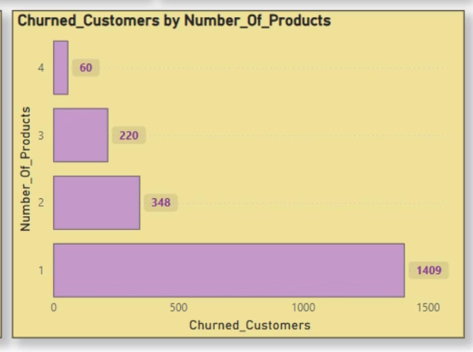
Churn Analysis by Number of Products
Customers with more products may have higher satisfaction but could also feel overwhelmed, leading to frustration in some cases.
The customers who use 3 or 4 products are less likely to churn.
The customers who use just 1 product are the customers who have churned the most. So, focusing on those customer bases can help to decrease the churn rate.

Slide 8
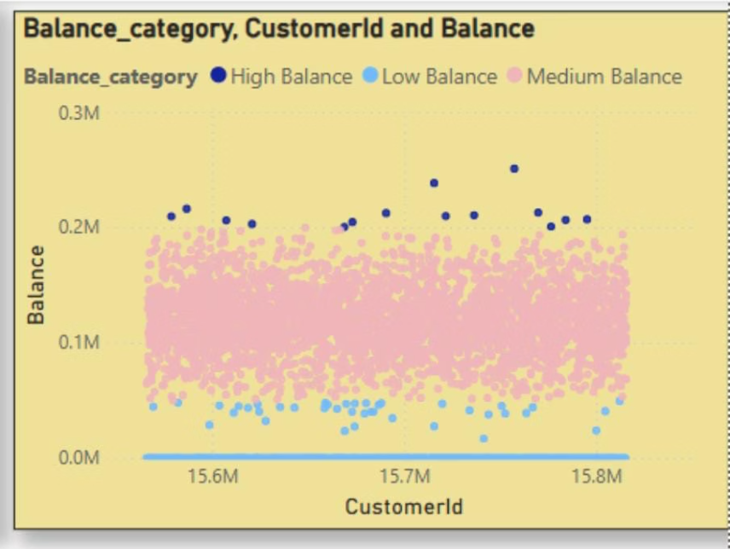
Identifying High-Balance Outliers in Retained Segment
Balance Segmentation Insights
High Balance (Dark Blue Dots):Customers with balances above 200K are key outliers. They are few in number and appear clearly separated at the top of the chart (220K–300K range).
Medium Balance (Pink Dots):The largest and most concentrated group, with balances between 50K–200K. No distinct outliers observed in this range.
Low Balance (Light Blue Dots):Some customers have very low or zero balances. While many fall in this category, only those at or near zero can be considered true outliers.

Slide 9
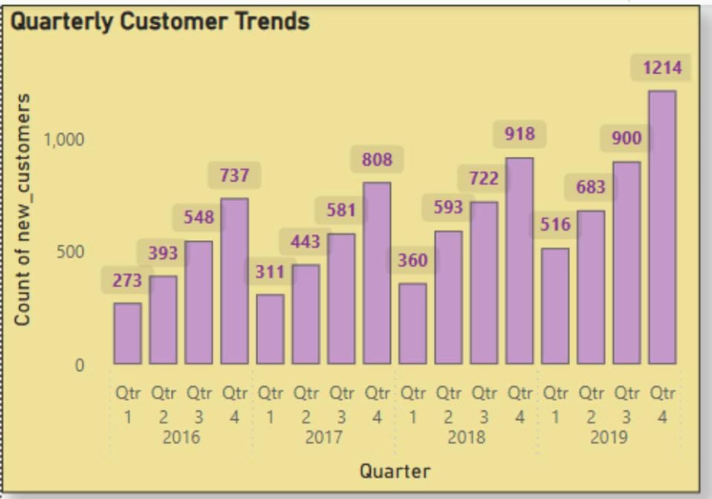
Customer Growth Analysis: Quarterly Trends by Year
New customer acquisition shows a consistent year-on-year increase from 2016 to 2019.
Q4 is the strongest quarter every year, with the highest number of new customers.
2019 saw the highest growth, ending with 1,214 new customers in Q4.
Each year follows an upward quarterly trend, starting lower in Q1 and peaking in Q4.

Slide 10
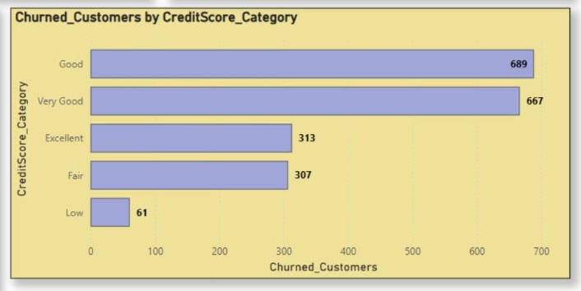
Churn Analysis: Credit Score Category Ranking
The chart ranks credit score categories by the number of churned customers (highest to lowest):
Good: 689 customers
Very Good: 667 customers
Excellent: 313 customers
Fair: 307 customers
Low: 61 customers

Slide 11
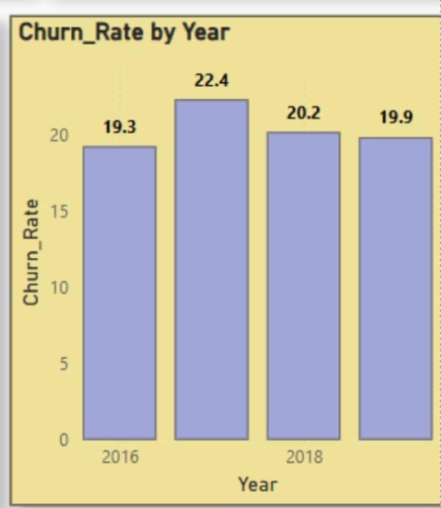
Year wise Churn Rate
From 2016 to 2019, the average churn rate was 20%, which is not ideal since a lower churn rate is preferable. A high churn rate can suggest that customers are dissatisfied with the services or do not find them valuable.
Strategies:
Targeted Bundles: Offer curated product bundles to single-product users for added value.
Enhanced Credit Card Rewards: Improve rewards, raise limits, reduce fees for valuable customers.
Retention Offers: Provide personalized deals before introductory offers expire.
Customer Feedback: Use regular surveys to identify churn reasons and improve services.
Relationship Management: Assign dedicated managers to high-value customers for personalized support.

Slide 12
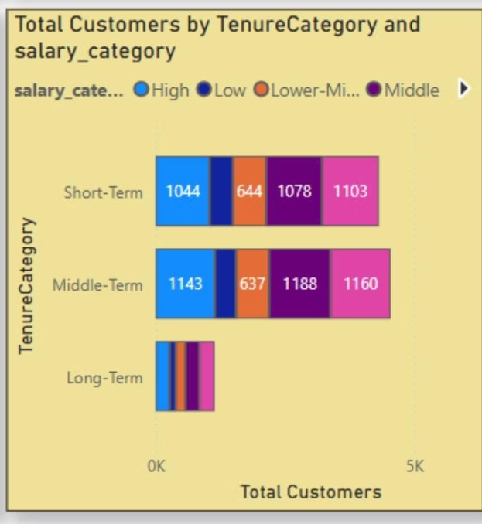
Customer Distribution by Tenure and Salary Segments
Customer Tenure Value Forecast:
Middle-Term & Short-Term customers dominate. Focus retention here.
Long-Term customers are fewer but valuable — nurture them.
Combine Salary, Credit Score, and Tenure for predictive modelling.
Use models (like Logistic Regression) to predict tenure and churn.
Focus on Upper-Middle salary segments for higher lifetime value.
Prioritize retention and upselling for Middle-Term customers.

Slide 13
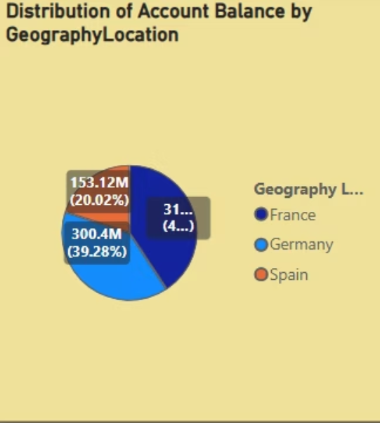
Balance Distribution across Location
The distribution of account balances across different regions is below:
France leads with the highest sum of balance, approximately at 311.33M (40.7%).
Germany follows closely with a sum of balance around 300.4M (39.28%).
Spain, however, has a significantly lower sum of balance, roughly at 153.12M (20.02%).

Slide 14
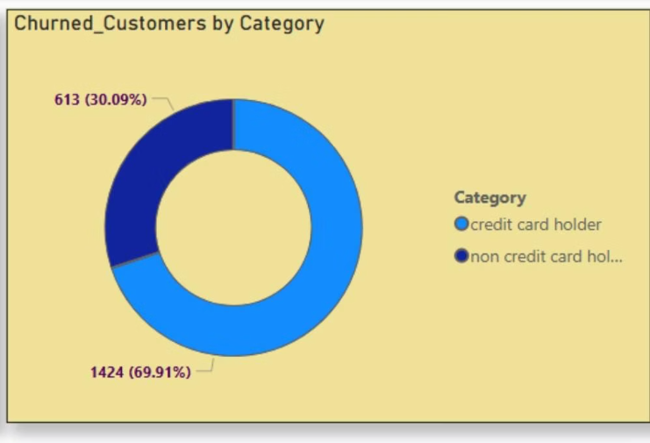
Impact of Credit Card on Churn
The chart indicates that a significantly higher number of customers with credit cards exited the bank (1,424) compared to those without credit cards (613).
This suggests a potential correlation between credit card ownership and churn.

Slide 15
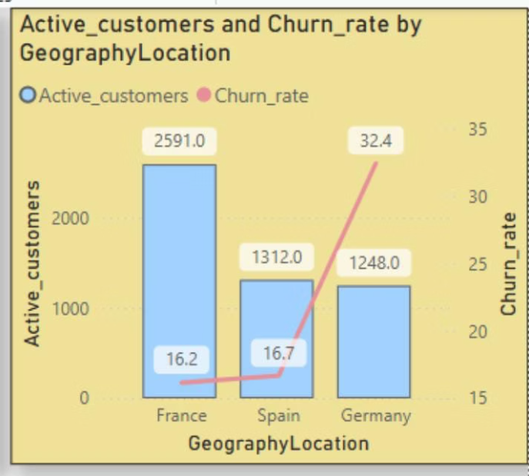
Active Customers & Churn Rate by Locations
France has the highest number of active customers (2,591) with a moderate churn rate of 16.2%, indicating strong customer retention and effective engagement strategies.
Spain maintains 1,312 active customers and a slightly higher churn rate of 16.7%, requiring close monitoring.
Germany shows the lowest active customer count (1,248) but a significantly high churn rate of 32.4%, suggesting possible dissatisfaction or low engagement despite a similar customer base to Spain.

Slide 16
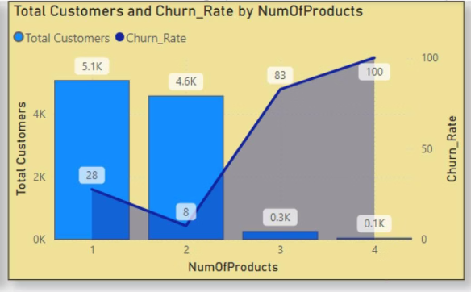
Customer Distribution and Churn Rate by Product Holding
Customers with fewer products exhibit lower churn rates compared to those with multiple product holdings.
The majority of customers hold 1 or 2 products (5.1K and 4.6K customers, respectively).
Churn is lowest (8%) among customers with 2 products.
Churn rises sharply for customers with 3 products (83%) and 4 products (100%), though these segments are very small.
Deep cross-selling (3+ products) is rare, indicating limited customer appetite or product fit.
Higher product count does not guarantee better retention; in fact, it correlates with higher churn.

Slide 17
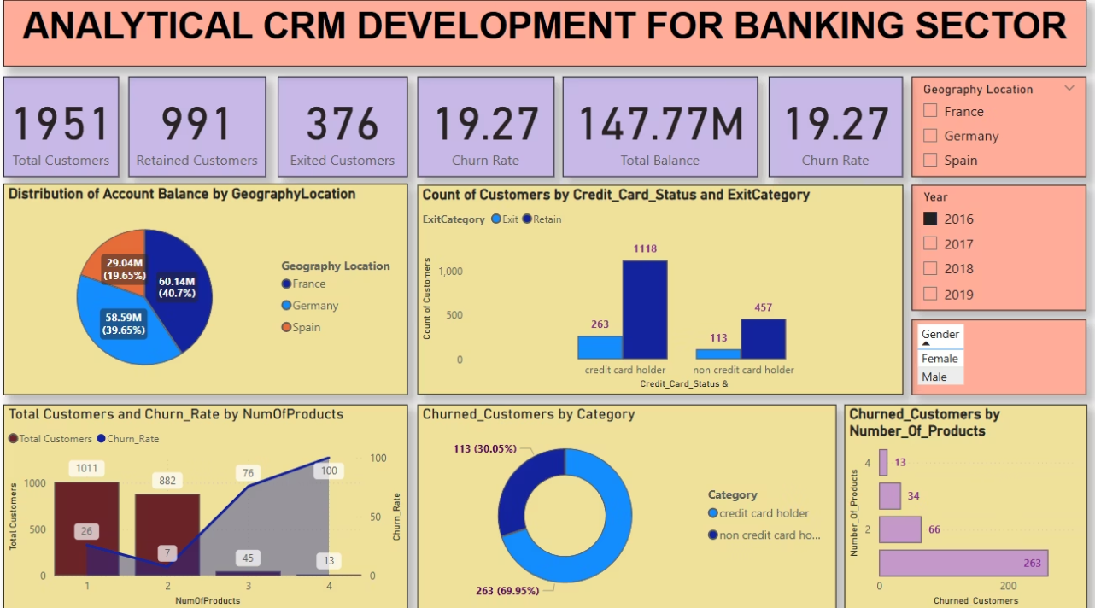
Dashboard

Slide 18
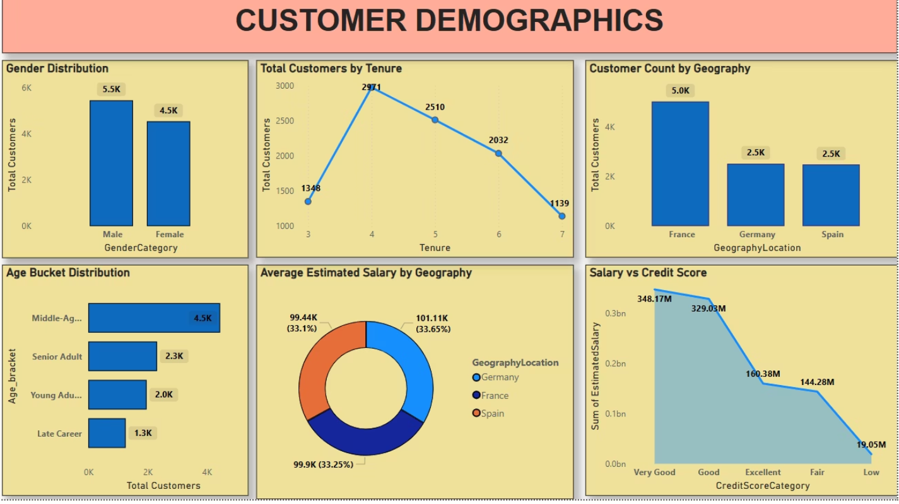

Slide 19
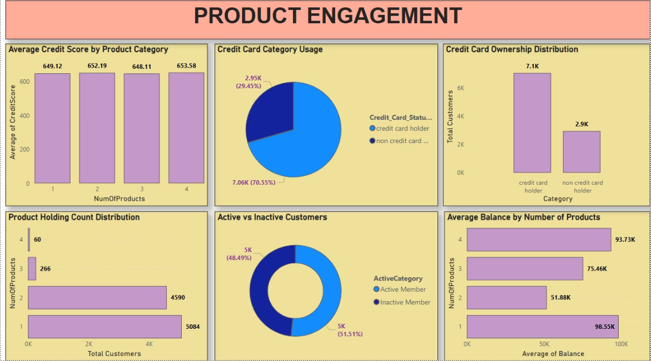

Slide 20
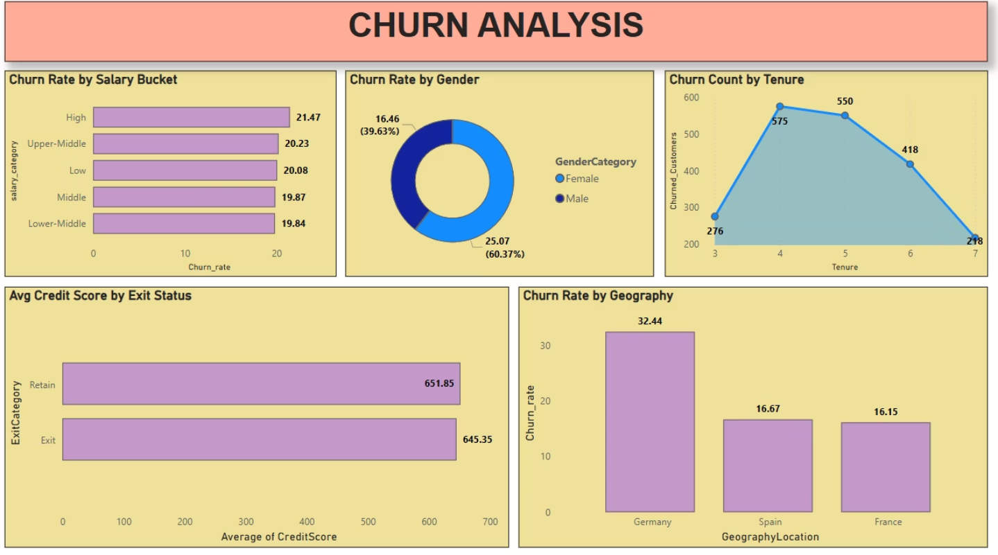

Slide 21
Conclusion
Churn Drivers: Low credit scores, fewer products, inactive status, and short tenure increase churn risk.
High-Risk Segments: Younger customers, low-balance holders, and certain regions show higher churn.
Age Impact: Older and middle-aged customers also churn significantly, requiring tailored retention strategies.
Key Insights: Dashboard reveals balance outliers and tracks churn trends, customer value, and risk indicators.
Strategic Focus: Enhance engagement, offer personalized products, and apply targeted retention campaigns.
Data-Driven Approach: Use continuous monitoring and predictive analytics to boost satisfaction and reduce churn.

Slide 22
Recommendations
Launch Targeted Retention Initiatives: Prioritize segments with low credit scores, short tenure, and inactive status.
Boost Customer Engagement: Drive cross-selling and encourage active participation across services.
Optimize Predictive Analytics: Regularly update churn and CLV models with fresh data for accuracy.
Track KPIs in Real Time: Leverage interactive dashboards to monitor churn, risk, and satisfaction metrics.
Incorporate Feedback Mechanisms: Use customer input to refine offerings and improve service quality.
Broaden Data Analysis: Integrate transactional and external data for more comprehensive insights.

Slide 23

Reference
Data : Newton School
Applications Used: MS Word, MS Power Point, MySQL, Power BI.

